Slide 1
Chapter 4: Synchronization & Deadlocks

Slide 2
Outline
Background
The Critical-Section Problem
Mutex Locks
Semaphores
Monitors

Slide 3
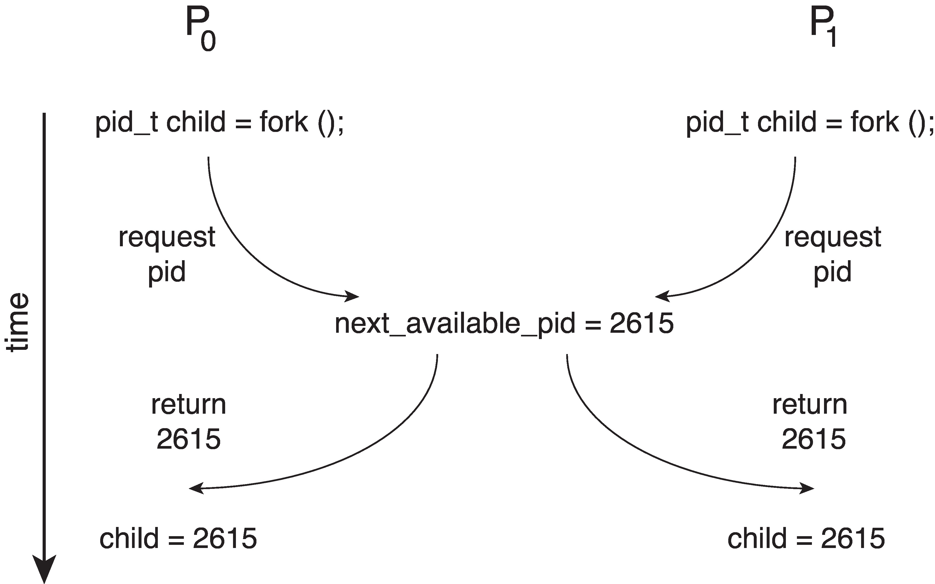
Race Condition
Processes P₀ and P₁ are creating child processes using the fork() system call
Race condition on kernel variable next_available_pid which represents the next available process identifier (pid)
Unless there is a mechanism to prevent P₀ and P₁ from accessing the variable next_available_pid the same pid could be assigned to two different processes!

Slide 4
Critical Section Problem
Consider system of n processes {p₀, p₁, … p_{n-1}}
Each process has critical section segment of code
Process may be changing common variables, updating table, writing file, etc.
When one process in critical section, no other may be in its critical section
Critical section problem is to design protocol to solve this
Each process must ask permission to enter critical section in entry section, may follow critical section with exit section, then remainder section

Slide 5
Critical-Section Problem (Cont.)
Requirements for solution to critical-section problem
Mutual Exclusion - If process P_{i} is executing in its critical section, then no other processes can be executing in their critical sections
Progress - If no process is executing in its critical section and there exist some processes that wish to enter their critical section, then the selection of the process that will enter the critical section next cannot be postponed indefinitely
Bounded Waiting - A bound must exist on the number of times that other processes are allowed to enter their critical sections after a process has made a request to enter its critical section and before that request is granted
Assume that each process executes at a nonzero speed
No assumption concerning relative speed of the n processes

Slide 6
Mutex Locks
Previous solutions are complicated and generally inaccessible to application programmers
OS designers build software tools to solve critical section problem
Simplest is mutex lock
Boolean variable indicating if lock is available or not
Protect a critical section by
First acquire() a lock
Then release() the lock
Calls to acquire() and release() must be atomic
Usually implemented via hardware atomic instructions such as compare-and-swap.
But this solution requires busy waiting
This lock therefore called a spinlock

Slide 7
Semaphore
Synchronization tool that provides more sophisticated ways (than Mutex locks) for processes to synchronize their activities.
Semaphore S – integer variable
Can only be accessed via two indivisible (atomic) operations
wait() and signal()
Originally called P() and V()
Definition of the wait() operation
wait(S) {
while (S <= 0)
; // busy wait
S--;
}
Definition of the signal() operation
signal(S) {
S++;
}

Slide 8
Semaphore (Cont.)
Counting semaphore – integer value can range over an unrestricted domain
Binary semaphore – integer value can range only between 0 and 1
Same as a mutex lock
Can implement a counting semaphore S as a binary semaphore
With semaphores we can solve various synchronization problems

Slide 9
Semaphore Usage Example (Self Study)
Solution to the CS Problem
Create a semaphore “mutex” initialized to 1
wait(mutex);
CS
signal(mutex);
Consider P₁ and P₂ that with two statements S₁ and S₂ and the requirement that S₁ to happen before S₂
Create a semaphore “synch” initialized to 0
P1:
S₁;
signal(synch);
P2:
wait(synch);
S₂;

Slide 10
Semaphore Implementation (Self Study)
Must guarantee that no two processes can execute the wait() and signal() on the same semaphore at the same time
Thus, the implementation becomes the critical section problem where the wait and signal code are placed in the critical section
Could now have busy waiting in critical section implementation
But implementation code is short
Little busy waiting if critical section rarely occupied
Note that applications may spend lots of time in critical sections and therefore this is not a good solution

Slide 11
Problems with Semaphores (Self Study)
Incorrect use of semaphore operations:
signal(mutex) …. wait(mutex)
wait(mutex) … wait(mutex)
Omitting of wait (mutex) and/or signal (mutex)
These – and others – are examples of what can occur when semaphores and other synchronization tools are used incorrectly.

Slide 12
Monitors (Self Study)
A high-level abstraction that provides a convenient and effective mechanism for process synchronization
Abstract data type, internal variables only accessible by code within the procedure
Only one process may be active within the monitor at a time
Pseudocode syntax of a monitor:
monitor monitor-name
{
// shared variable declarations
procedure P1 (…) { …. }
procedure P2 (…) { …. }
procedure Pn (…) {……}
initialization code (…) { … }
}

Slide 13
Monitor Implementation Using Semaphores (Self Study)
Variables
semaphore mutex
mutex = 1
Each procedure P is replaced by
wait(mutex);
…
body of P;
…
signal(mutex);
Mutual exclusion within a monitor is ensured

Slide 14
Chapter 4 (Cont’d): Synchronization Examples

Slide 15
Outline
Explain the bounded-buffer synchronization problem
Explain the readers-writers synchronization problem
Explain and dining-philosophers synchronization problems

Slide 16
Classical Problems of Synchronization
Classical problems used to test newly-proposed synchronization schemes
Bounded-Buffer Problem
Readers and Writers Problem
Dining-Philosophers Problem

Slide 17
Bounded-Buffer Problem
n buffers, each can hold one item
Semaphore mutex initialized to the value 1
Semaphore full initialized to the value 0
Semaphore empty initialized to the value n

Slide 18
Bounded Buffer Problem (Cont.) (Self Study)
The structure of the producer process
while (true) {
... /* produce an item in next_produced */
...
wait(empty);
wait(mutex);
... /* add next produced to the buffer */
...
signal(mutex);
signal(full);
}

Slide 19
Bounded Buffer Problem (Cont.) (Self Study)
The structure of the consumer process
while (true) {
wait(full);
wait(mutex);
... /* remove an item from buffer to next_consumed */
...
signal(mutex);
signal(empty);
... /* consume the item in next consumed */
... }

Slide 20
Readers-Writers Problem
A data set is shared among a number of concurrent processes
Readers – only read the data set; they do not perform any updates
Writers – can both read and write
Problem – allow multiple readers to read at the same time
Only one single writer can access the shared data at the same time
Several variations of how readers and writers are considered – all involve some form of priorities

Slide 21
Readers-Writers Problem (Cont.)
Shared Data
Data set
Semaphore rw_mutex initialized to 1
Semaphore mutex initialized to 1
Integer read_count initialized to 0

Slide 22
Readers-Writers Problem (Cont.) (Self Study)
The structure of a writer process
while (true) { wait(rw_mutex);
... /* writing is performed */
...
signal(rw_mutex);
}

Slide 23
Readers-Writers Problem (Cont.) (Self Study)
The structure of a reader process
while (true){ wait(mutex); read_count++; if (read_count == 1) /* first reader */
wait(rw_mutex);
signal(mutex);
... /* reading is performed */
...
wait(mutex); read_count--; if (read_count == 0) /* last reader */
signal(rw_mutex);
signal(mutex);
}

Slide 24

Dining-Philosophers Problem
N philosophers’ sit at a round table with a bowel of rice in the middle.
They spend their lives alternating thinking and eating.
They do not interact with their neighbors.
Occasionally try to pick up 2 chopsticks (one at a time) to eat from bowl
Need both to eat, then release both when done
In the case of 5 philosophers, the shared data
Bowl of rice (data set)
Semaphore chopstick [5] initialized to 1

Slide 25
Dining-Philosophers Problem Algorithm (Self Study)
Semaphore Solution
The structure of Philosopher i :
while (true){
wait (chopstick[i] );
wait (chopStick[ (i + 1) % 5] );
/* eat for awhile */
signal (chopstick[i] );
signal (chopstick[ (i + 1) % 5] );
/* think for awhile */
}
What is the problem with this algorithm?

Slide 26
Chapter 4 (Cont’d): Deadlocks

Slide 27
Outline
System Model
Deadlock Characterization
Methods for Handling Deadlocks
Deadlock Prevention
Deadlock Avoidance
Deadlock Detection
Recovery from Deadlock

Slide 28
System Model
System consists of resources
Resource types R₁, R₂, . . ., R_{m}
CPU cycles, memory space, I/O devices
Each resource type R_{i} has W_{i} instances.
Each process utilizes a resource as follows:
request
use
release

Slide 29
Deadlock with Semaphores (Self Study)
Data:
A semaphore S₁ initialized to 1
A semaphore S₂ initialized to 1
Two threads T₁ and T₂
T₁:
wait(s₁)
wait(s₂)
T₂:
wait(s₂)
wait(s₁)

Slide 30
Deadlock Characterization
Deadlock can arise if four conditions hold simultaneously.
Mutual exclusion: only one thread at a time can use a resource
Hold and wait: a thread holding at least one resource is waiting to acquire additional resources held by other threads
No preemption: a resource can be released only voluntarily by the thread holding it, after that thread has completed its task
Circular wait: there exists a set {T₀, T₁, …, T_{n}} of waiting threads such that T₀ is waiting for a resource that is held by T₁, T₁ is waiting for a resource that is held by T₂, …, T_{n–1} is waiting for a resource that is held by T_{n}, and T_{n} is waiting for a resource that is held by T₀.

Slide 31
Resource-Allocation Graph
A set of vertices V and a set of edges E.
V is partitioned into two types:
T = {T₁, T₂, …, T_{n}}, the set consisting of all the threads in the system.
R = {R₁, R₂, …, R_{m}}, the set consisting of all resource types in the system
request edge – directed edge T_{i} → R_{j}
assignment edge – directed edge R_{j} → T_{i}

Slide 32
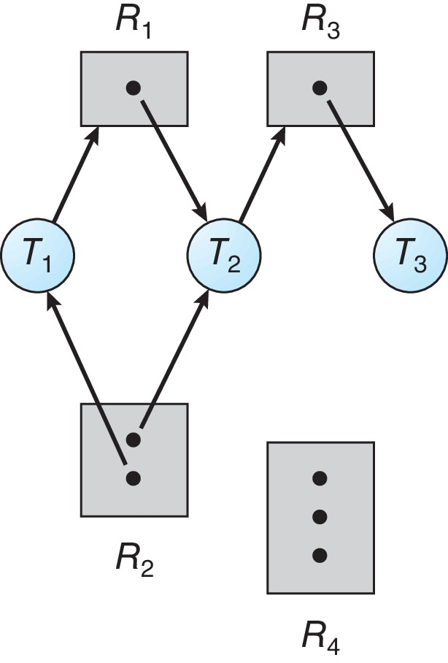
Resource Allocation Graph Example
One instance of R₁
Two instances of R₂
One instance of R₃
Three instance of R₄
T₁ holds one instance of R₂ and is waiting for an instance of R₁
T₂ holds one instance of R₁, one instance of R₂, and is waiting for an instance of R₃
T₃ is holds one instance of R₃

Slide 33
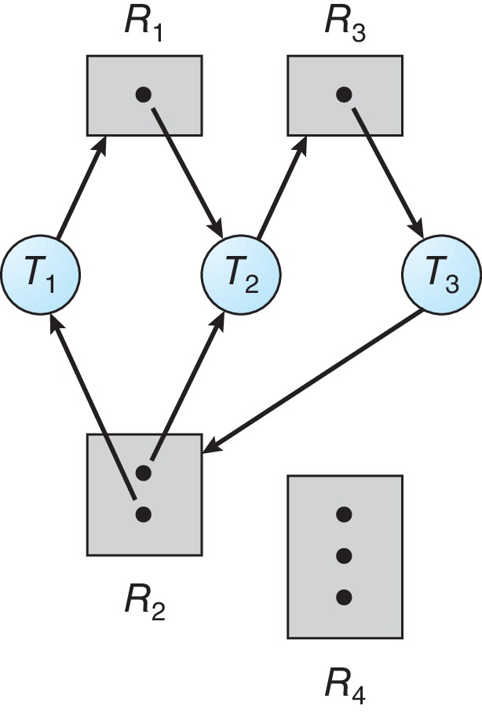
Resource Allocation Graph with a Deadlock

Slide 34
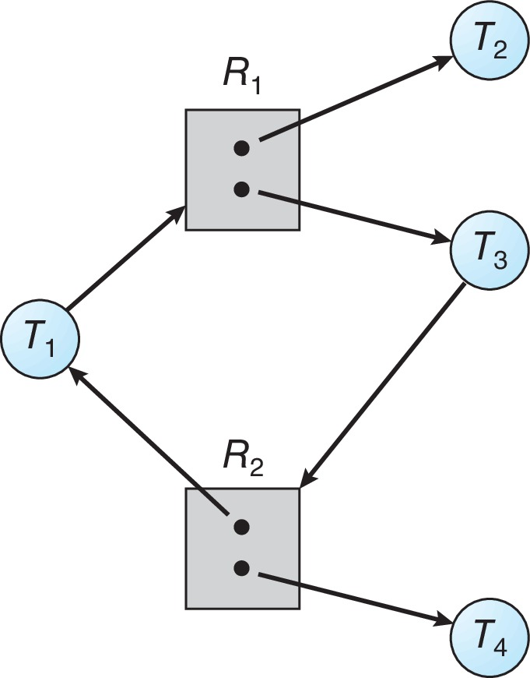
Graph with a Cycle But no Deadlock

Slide 35
Basic Facts
If graph contains no cycles ⇒ no deadlock
If graph contains a cycle ⇒
if only one instance per resource type, then deadlock
if several instances per resource type, possibility of deadlock

Slide 36
Methods for Handling Deadlocks
Ensure that the system will never enter a deadlock state:
Deadlock prevention
Deadlock avoidance
Allow the system to enter a deadlock state and then recover
Ignore the problem and pretend that deadlocks never occur in the system.

Slide 37
Deadlock Prevention
Invalidate one of the four necessary conditions for deadlock:
Mutual Exclusion – not required for sharable resources (e.g., read-only files); must hold for non-sharable resources
Hold and Wait – must guarantee that whenever a thread requests a resource, it does not hold any other resources
Require threads to request and be allocated all its resources before it begins execution or allow thread to request resources only when the thread has none allocated to it.
Low resource utilization; starvation possible

Slide 38
Deadlock Prevention (Cont.)
No Preemption:
If a process that is holding some resources requests another resource that cannot be immediately allocated to it, then all resources currently being held are released
Preempted resources are added to the list of resources for which the thread is waiting
Thread will be restarted only when it can regain its old resources, as well as the new ones that it is requesting
Circular Wait:
Impose a total ordering of all resource types, and require that each thread requests resources in an increasing order of enumeration

Slide 39
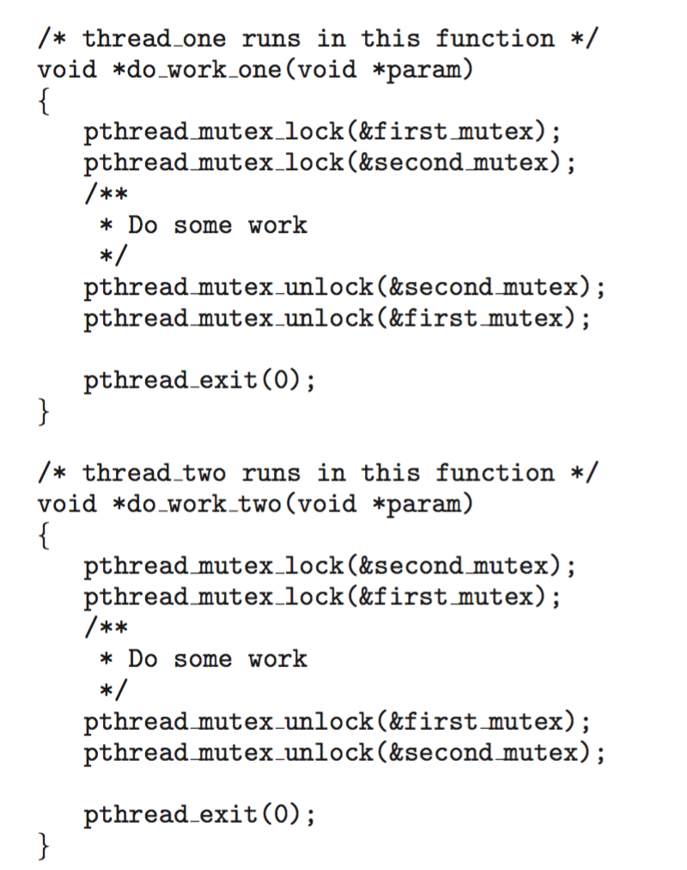
Circular Wait
Invalidating the circular wait condition is most common.
Simply assign each resource (i.e., mutex locks) a unique number.
Resources must be acquired in order.
If: first_mutex = 1 second_mutex = 5 code for thread_two could not be written as follows:

Slide 40
Deadlock Avoidance
Requires that the system has some additional a priori information available
Simplest and most useful model requires that each thread declare the maximum number of resources of each type that it may need
The deadlock-avoidance algorithm dynamically examines the resource-allocation state to ensure that there can never be a circular-wait condition
Resource-allocation state is defined by the number of available and allocated resources, and the maximum demands of the processes

Slide 41
Safe State
When a thread requests an available resource, system must decide if immediate allocation leaves the system in a safe state
System is in safe state if there exists a sequence <T₁, T₂, …, T_{n}> of ALL the threads in the systems such that for each T_{i}, the resources that T_{i} can still request can be satisfied by currently available resources + resources held by all the T_{j}, with j < I
That is:
If T_{i} resource needs are not immediately available, then T_{i} can wait until all T_{j} have finished
When T_{j} is finished, T_{i} can obtain needed resources, execute, return allocated resources, and terminate
When T_{i} terminates, T_{i +1} can obtain its needed resources, and so on

Slide 42
Basic Facts
If a system is in safe state ⇒ no deadlocks
If a system is in unsafe state ⇒ possibility of deadlock
Avoidance ⇒ ensure that a system will never enter an unsafe state.

Slide 43
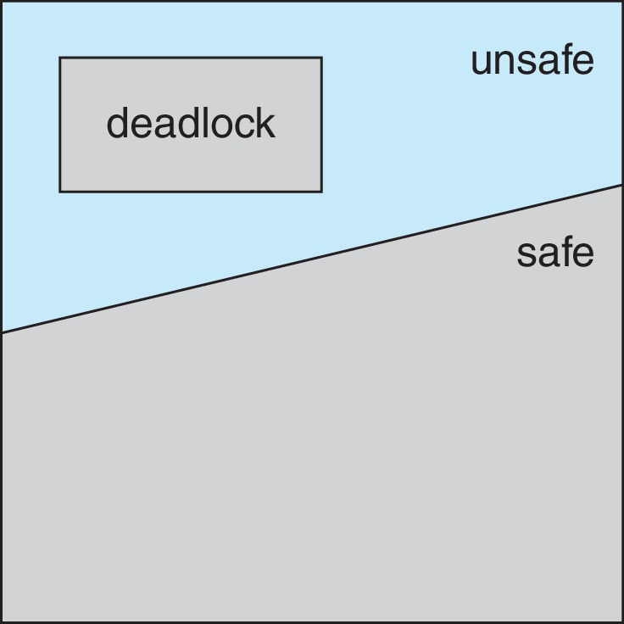
Safe, Unsafe, Deadlock State

Slide 44
Avoidance Algorithms
Single instance of a resource type
Use a resource-allocation graph
Multiple instances of a resource type
Use the Banker’s Algorithm

Slide 45
Banker’s Algorithm
Multiple instances of resources
Each thread must a priori claim maximum use
When a thread requests a resource, it may have to wait
When a thread gets all its resources it must return them in a finite amount of time

Slide 46
Example : Banker’s Algorithm
Considering a system with five processes P0 through P4 and three resources types A, B, C. Resource type A has 5 instances, B has 10 instances and C has 7 instances. Suppose at time t₀ following snapshot of the system has been taken:
By applying banker’s algorithm
What will be the content of need matrix?
Is the system in safe state? If yes, then what is the safe sequence?
Step 1:
i) Need = Max – Alloc
Step 2:
Work = Available = [ 3, 3, 2]
Finish (i)= [ F, F, F, F, F]
Step 3:
ii) System is in safe state, and the safe sequence is: P1➔P3➔P4➔P0➔P2
Process | Allocation |  |  | Max |  |  | Available
 | A | B | C | A | B | C | A | B | C
P0 | 1 | 0 | 0 | 5 | 7 | 3 | 3 | 3 | 2
P1 | 0 | 2 | 0 | 2 | 3 | 2
P2 | 0 | 3 | 2 | 0 | 9 | 2
P3 | 1 | 2 | 1 | 2 | 2 | 2
P4 | 0 | 0 | 2 | 3 | 4 | 3
➔ P0 | 4 | 7 | 3
P1 | 2 | 1 | 2
P2 | 0 | 6 | 0
P3 | 1 | 0 | 1
P4 | 3 | 4 | 2
Find the process where need<=work | If so, work=work+allocation | Finish (i) = True
P1 | ➔[3,3,2] + [0,2,0] ➔[ 3, 5, 2] | [ F, T, F, F, F]
P3 | ➔[3,5,2] + [1, 2, 1] ➔ [4,7,3] | [ F, T, F, T, F]
P4 | ➔[4,7,3] + [0,0,2] ➔ [4,7,5] | [ F, T, F, T, T]
P0 | ➔[4,7,5] + [1,0,0] ➔[5,7,5] | [ T, T, F, T, T]
P2 | ➔[5,7,5] + [0,3,2] ➔[5,10,7] | [ T, T, T, T, T]

Slide 47
Data Structures for the Banker’s Algorithm (Self Study)
Let n = number of processes, and m = number of resources types.
Available: Vector of length m. If available [j] = k, there are k instances of resource type R_{j} available
Max: n x m matrix. If Max [i,j] = k, then process T_{i} may request at most k instances of resource type R_{j}
Allocation: n x m matrix. If Allocation[i,j] = k then T_{i} is currently allocated k instances of R_{j}
Need: n x m matrix. If Need[i,j] = k, then T_{i} may need k more instances of R_{j} to complete its task
Need [i,j] = Max[i,j] – Allocation [i,j]

Slide 48
Safety Algorithm (Self Study)
Let Work and Finish be vectors of length m and n, respectively. Initialize:
Work = Available
Finish [i] = false for i = 0, 1, …, n- 1
Find an i such that both:
(a) Finish [i] = false
(b) Need_{i} ≤ Work
If no such i exists, go to step 4
Work = Work + Allocation_{i} Finish[i] = true go to step 2
If Finish [i] == true for all i, then the system is in a safe state

Slide 49
Resource-Request Algorithm for Process P_{i} (Self Study)
Request_{i} = request vector for process T_{i}. If Request_{i} [j] = k then process T_{i} wants k instances of resource type R_{j}
If Request_{i} ≤ Need_{i} go to step 2. Otherwise, raise error condition, since process has exceeded its maximum claim
If Request_{i} ≤ Available, go to step 3. Otherwise T_{i} must wait, since resources are not available
Pretend to allocate requested resources to T_{i} by modifying the state as follows:
Available = Available – Request_{i};
Allocation_{i} = Allocation_{i} + Request_{i};
Need_{i} = Need_{i} – Request_{i};
If safe ⇒ the resources are allocated to T_{i}
If unsafe ⇒ T_{i} must wait, and the old resource-allocation state is restored

Slide 50
Deadlock Detection
Allow system to enter deadlock state
Detection algorithm
Recovery scheme

Slide 51
Single Instance of Each Resource Type (Self Study)
Maintain wait-for graph
Nodes are threads
T_{i} → T_{j} if T_{i} is waiting for T_{j}
Periodically invoke an algorithm that searches for a cycle in the graph. If there is a cycle, there exists a deadlock
An algorithm to detect a cycle in a graph requires an order of n² operations, where n is the number of vertices in the graph

Slide 52
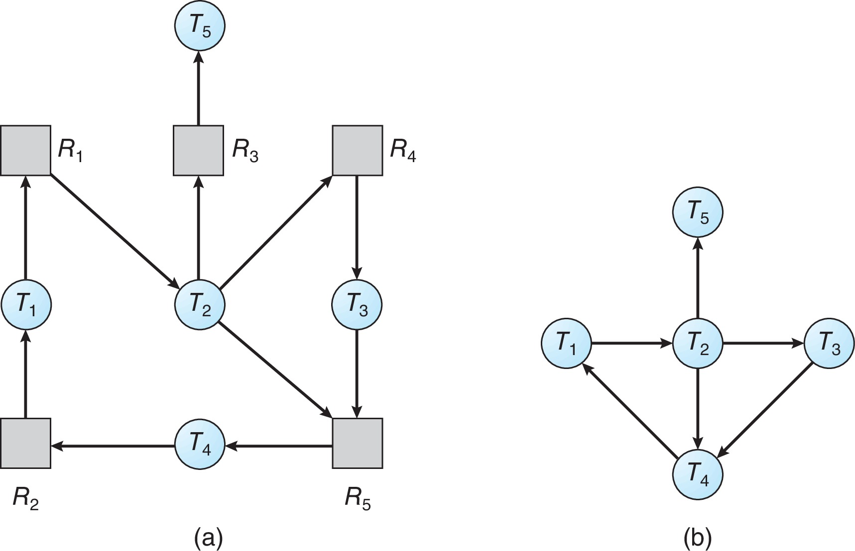
Resource-Allocation Graph and Wait-for Graph (Self Study)
Resource-Allocation Graph
Corresponding wait-for graph

Slide 53
Several Instances of a Resource Type (Self Study)
Available: A vector of length m indicates the number of available resources of each type
Allocation: An n x m matrix defines the number of resources of each type currently allocated to each thread.
Request: An n x m matrix indicates the current request of each thread. If Request [i][j] = k, then thread T_{i} is requesting k more instances of resource type R_{j}.

Slide 54
Detection Algorithm (Self Study)
Let Work and Finish be vectors of length m and n, respectively Initialize:
Work = Available
For i = 1,2, …, n, if Allocation_{i} ≠ 0, then Finish[i] = false; otherwise, Finish[i] = true
Find an index i such that both:
Finish[i] == false
Request_{i} ≤ Work
If no such i exists, go to step 4

Slide 55
Detection Algorithm (Cont.) (Self Study)
Work = Work + Allocation_{i} Finish[i] = true go to step 2
If Finish[i] == false, for some i, 1 ≤ i ≤ n, then the system is in deadlock state. Moreover, if Finish[i] == false, then T_{i} is deadlocked
Algorithm requires an order of O(m x n²) operations to detect whether the system is in deadlocked state

Slide 56
Example of Detection Algorithm
Five threads T₀ through T₄; three resource types A (7 instances), B (2 instances), and C (6 instances)
Snapshot at time T₀:
Allocation Request Available
A B C A B C A B C
T₀ 0 1 0 0 0 0 0 0 0
T₁ 2 0 0 2 0 2
T₂ 3 0 3 0 0 0
T₃ 2 1 1 1 0 0
T₄ 0 0 2 0 0 2
Sequence <T₀, T₂, T₃, T₁, T₄> will result in Finish[i] = true for all i

Slide 57
Example (Cont.)
T₂ requests an additional instance of type C
Request
A B C
T₀ 0 0 0
T₁ 2 0 2
T₂ 0 0 1
T₃ 1 0 0
T₄ 0 0 2
State of system?
Can reclaim resources held by thread T₀, but insufficient resources to fulfill other processes; requests
Deadlock exists, consisting of processes T₁, T₂, T₃, and T₄

Slide 58
Detection-Algorithm Usage (Self Study)
When, and how often, to invoke depends on:
How often a deadlock is likely to occur?
How many processes will need to be rolled back?
one for each disjoint cycle
If detection algorithm is invoked arbitrarily, there may be many cycles in the resource graph and so we would not be able to tell which of the many deadlocked threads “caused” the deadlock.

Slide 59
Recovery from Deadlock: Process Termination
Abort all deadlocked threads
Abort one process at a time until the deadlock cycle is eliminated
In which order should we choose to abort?
Priority of the thread
How long has the thread computed, and how much longer to completion
Resources that the thread has used
Resources that the thread needs to complete
How many threads will need to be terminated
Is the thread interactive or batch?

Slide 60
Recovery from Deadlock: Resource Preemption
Selecting a victim – minimize cost
Rollback – return to some safe state, restart the thread for that state
Starvation – same thread may always be picked as victim, include number of rollback in cost factor

Slide 61
End of Chapter 4

